Slide 1

FED
WE
E
K
Responsive Navigation Bar
CSS Animation
Front End Development
Diploma in CSF
Year 1 (2021/22), Semester 2
5

Slide 2
Remote Learning Instructions
Step 1
Read the given slides
Details in slide 1-14
Step 2
Perform highlighted activities in Activities slide
Details in slide 15
Step 3
Complete and Submit Tasks given
Details in slide 16

Slide 3
Topics
Responsive Navigation Bar
Collapsible Responsive Navigation Bar
Include HTML Files
CSS Animation
CSS Transitions
CSS Transforms

Slide 4
Learning Objectives
Using Bootstrap Framework to implement navigation bar which will collapse into a toggle button and drop-down list in a smaller screen.
Using “Include HTML” feature to add the same navigation bar to all pages (Global navigation system).
Using CSS properties only (without JavaScript or Flash) to produce animated interactive effects.

Slide 5


Responsive Navigation Bar (Navbar)
Navigation bar takes up substantial screen space.
For devices with small screen, it is a common practice to hide the navbar, only to display it as a drop-down list upon clicking a toggle button:
Bootstrap framework provides CCS classes to build a collapsible navigation bar.
Note: Refer to practical
handout for implementation details and code explanation.

Slide 6
Include HTML File
The navigation bar on each page of a website usually has the same design and contains the same links which allow navigation to each another.
To maintain design consistency and avoiding code duplication, the common header (contains navigation bar) and footer are implemented as separate HTML pages and then “included” to all pages of the website.
W3School.com provide a JavaScript function includeHTML() which allows inclusion of a HTML page in another, you specify where you want to include the page with the w3-include-html attribute in a <div> element:
<div w3-include-html=“header.html"></div>

Slide 7
Introduction to CSS Transitions
CSS transitions allows you to change property values of a HTML element over a given duration.
It is used to implement mouse-over effect, aimed at catching user attention when hovering over an element.
Example: (Note: “div” is a red block of 100px by 100px initially)
<head> <style> div { width: 100px; height: 100px; background: red; transition: width 2s; } div:hover { width: 300px; } </style> </head> <body> <p>Hover over the div element below, the width of the width of the square will expand gradually from 100px to 300px, within 2 seconds:</p> <div></div> </body>

Slide 8
Introduction to CSS Transitions
When applying a transition, you need to specify:
CSS property to change (transition-property) (Required)
How long it should take (transition-duration) (Required)
How the transition accelerates (transition-timing-function)
Should there be a pause before it starts (transition-delay)
Timing Functions: (Incomplete list, default: ease)
ease - starts slowly, accelerates quickly, slows down at the end
linear - stays consistent from the beginning to end
ease-in - starts slowly, then speeds up
ease-out - starts out fast, then slows down
ease-in-out - starts slowly, speeds up, slows down at the very end, similar to ease, but with less pronounced acceleration

Slide 9
Introduction to CSS Transforms
The @keyframes rule specifies the animation code.
CSS Transforms allows you to rotate, relocate, resize, and skew HTML elements in both 2 and 3D space.
2D transform functions: (Incomplete list)
scale(): affects the size of the element, in both horizontal and vertical direction.
skewX() and skewY(): tilts an element horizontally or vertically, like turning a rectangle into a parallelogram.
translate(): moves an element sideways (horizontally) or up and down (vertically).
rotate(): rotates the element clockwise from its current position by a certain degree.

Slide 10
CSS Keyframes Animation
Animation is created by gradually changing from one set of CSS styles to another.
During the animation, you can change the set of CSS styles many times.
Transition property is applied to achieve a smooth transition
Transform property can by applied to achieve movement
The @keyframes rule specifies the animation code.
Specify when the style change will happen in percent, or with the keywords "from" and "to"
0% is the beginning of the animation
100% is when the animation is complete.

Slide 11
CSS Keyframes Animation
Example: Bouncing and Rotating Ball:
<html> <head> <style> body { display: flex; justify-content: center; } .box { width: 300px; height: 300px; border: solid thick brown; } .ball { width: 100px; height: 100px; border-radius: 50%; background-color: #FF5722; text-align: center; vertical-align: middle; line-height: 100px; animation: bounce 2.0s; animation-direction: alternate; animation-timing-function: ease-in; animation-iteration-count: infinite; } @keyframes bounce { 0% { transform: translate(0, 0) rotate(0deg); } 100% { transform: translate(200px, 200px) rotate(360deg); } } </style>

Slide 12
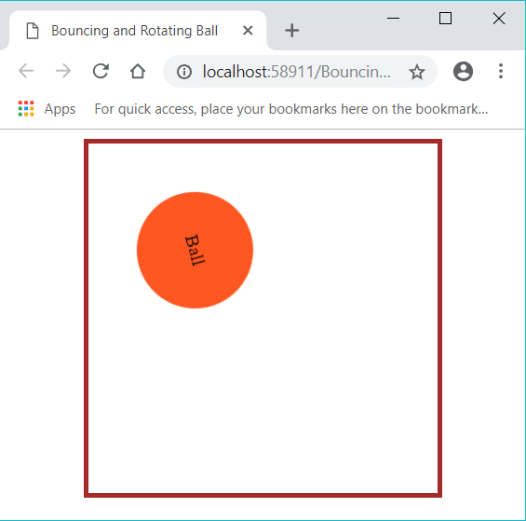
CSS Keyframes Animation
Example: Bouncing and Rotating Ball (Continued):
</head> <body> <div class="box"> <div class="ball">Ball</div> </div> </body> </html>

Slide 13
Notes on Worksheet
Much like week 4 worksheet, week 5 worksheet is very much guided.
Focus is on creating responsive navigation bar using bootstrap.

Slide 14

Reference
Learning Web Design
A Beginner’s Guide to HTML, CSS, JavaScript and Web Graphics
Jennifer Niederst Robbins
Chapter 18
Available to download from NP library:
https://ebookcentral.proquest.com/lib/np/detail.action?docID=5412749&query=Learning+Web+Design
Lynda.com:
Bootstrap 4 Essential Training
CSS: Animation

Slide 15

Activities
Read the following chapters from the textbook as reference materials.
Chapter 17 – Responsive Web Design
Read W3Schools Bootstrap 4 materials. Emphasize on Bootstrap Navs & Navbar.
W3Schools Bootstrap 4 Tutorial - https://www.w3schools.com/bootstrap4/default.asp

Slide 16
Tasks
Complete Week 5 Practical.
Download Week 5 Practical in MEL – “FED 2021-10 Week 5 Worksheet.pdf”
Deadline end of Week 5
Submit the completed practical files in MEL.
Zipped the source files
Name the zipped file in following format:-
FED-Week05-SXXXXXXXX (where SXXXXXXXX is your student id)
Submit the zipped file in the weekly folder’s submission link in MEL
Also, submit the zipped file into FED network folder (https:///ictspace.ict.np.edu.sg/FED) under your studentID. This is for backup purpose only. Main submission is still in MEL.
If you have any questions please communicate with your tutor via Microsoft Teams.

Slide 17
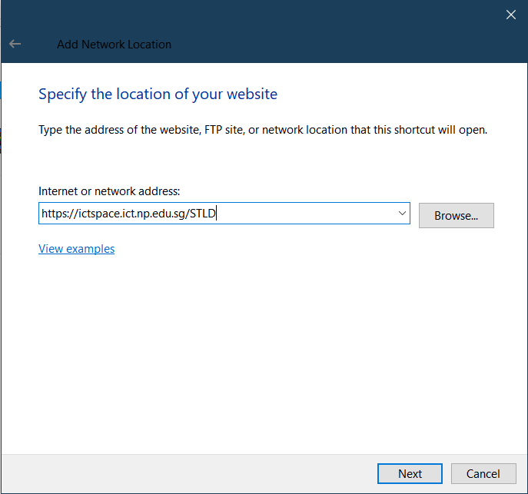
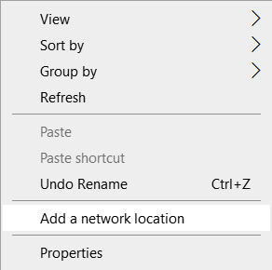
Appendix
Mapped to FED network folder
For Win Users
Right click on a blank space in your Windows Explorer
Select ‘Add a network location’
3. Enter https://ictspace.ict.np.edu.sg/(your assigned module)
4. Press ‘Next’

Slide 18
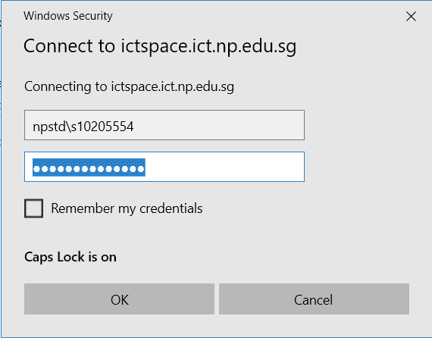
Appendix (Cont)
10123453
4. Login using npstd\s(your student ID number without the last alphabet)
5. Enter your NP student account password

Slide 19
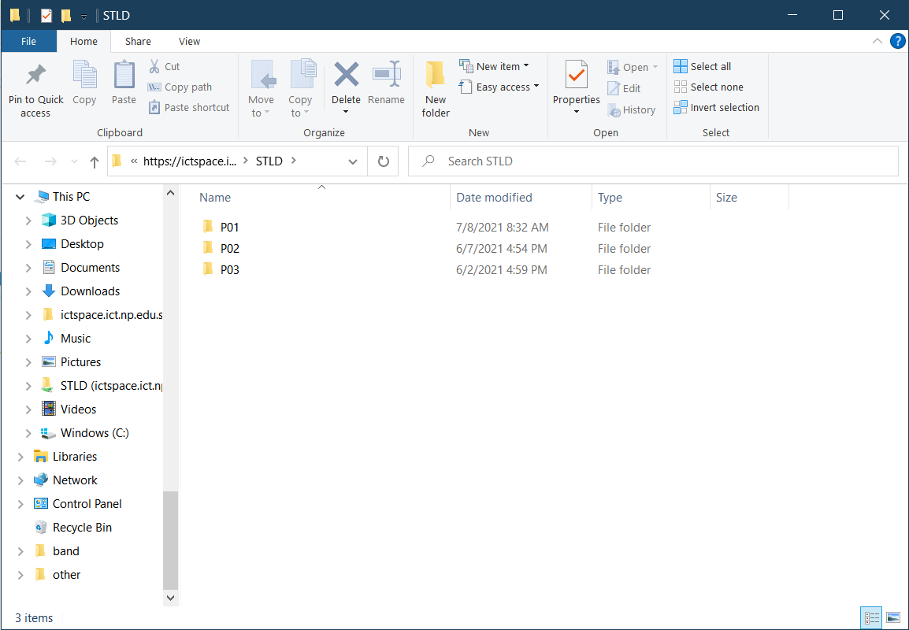
Appendix (Cont)
You should be able to see your class folder as shown in the example below.

